Slide 1
工作坊

Slide 2
安排
Dapr 101
实例 程序
上手 实验

Slide 3
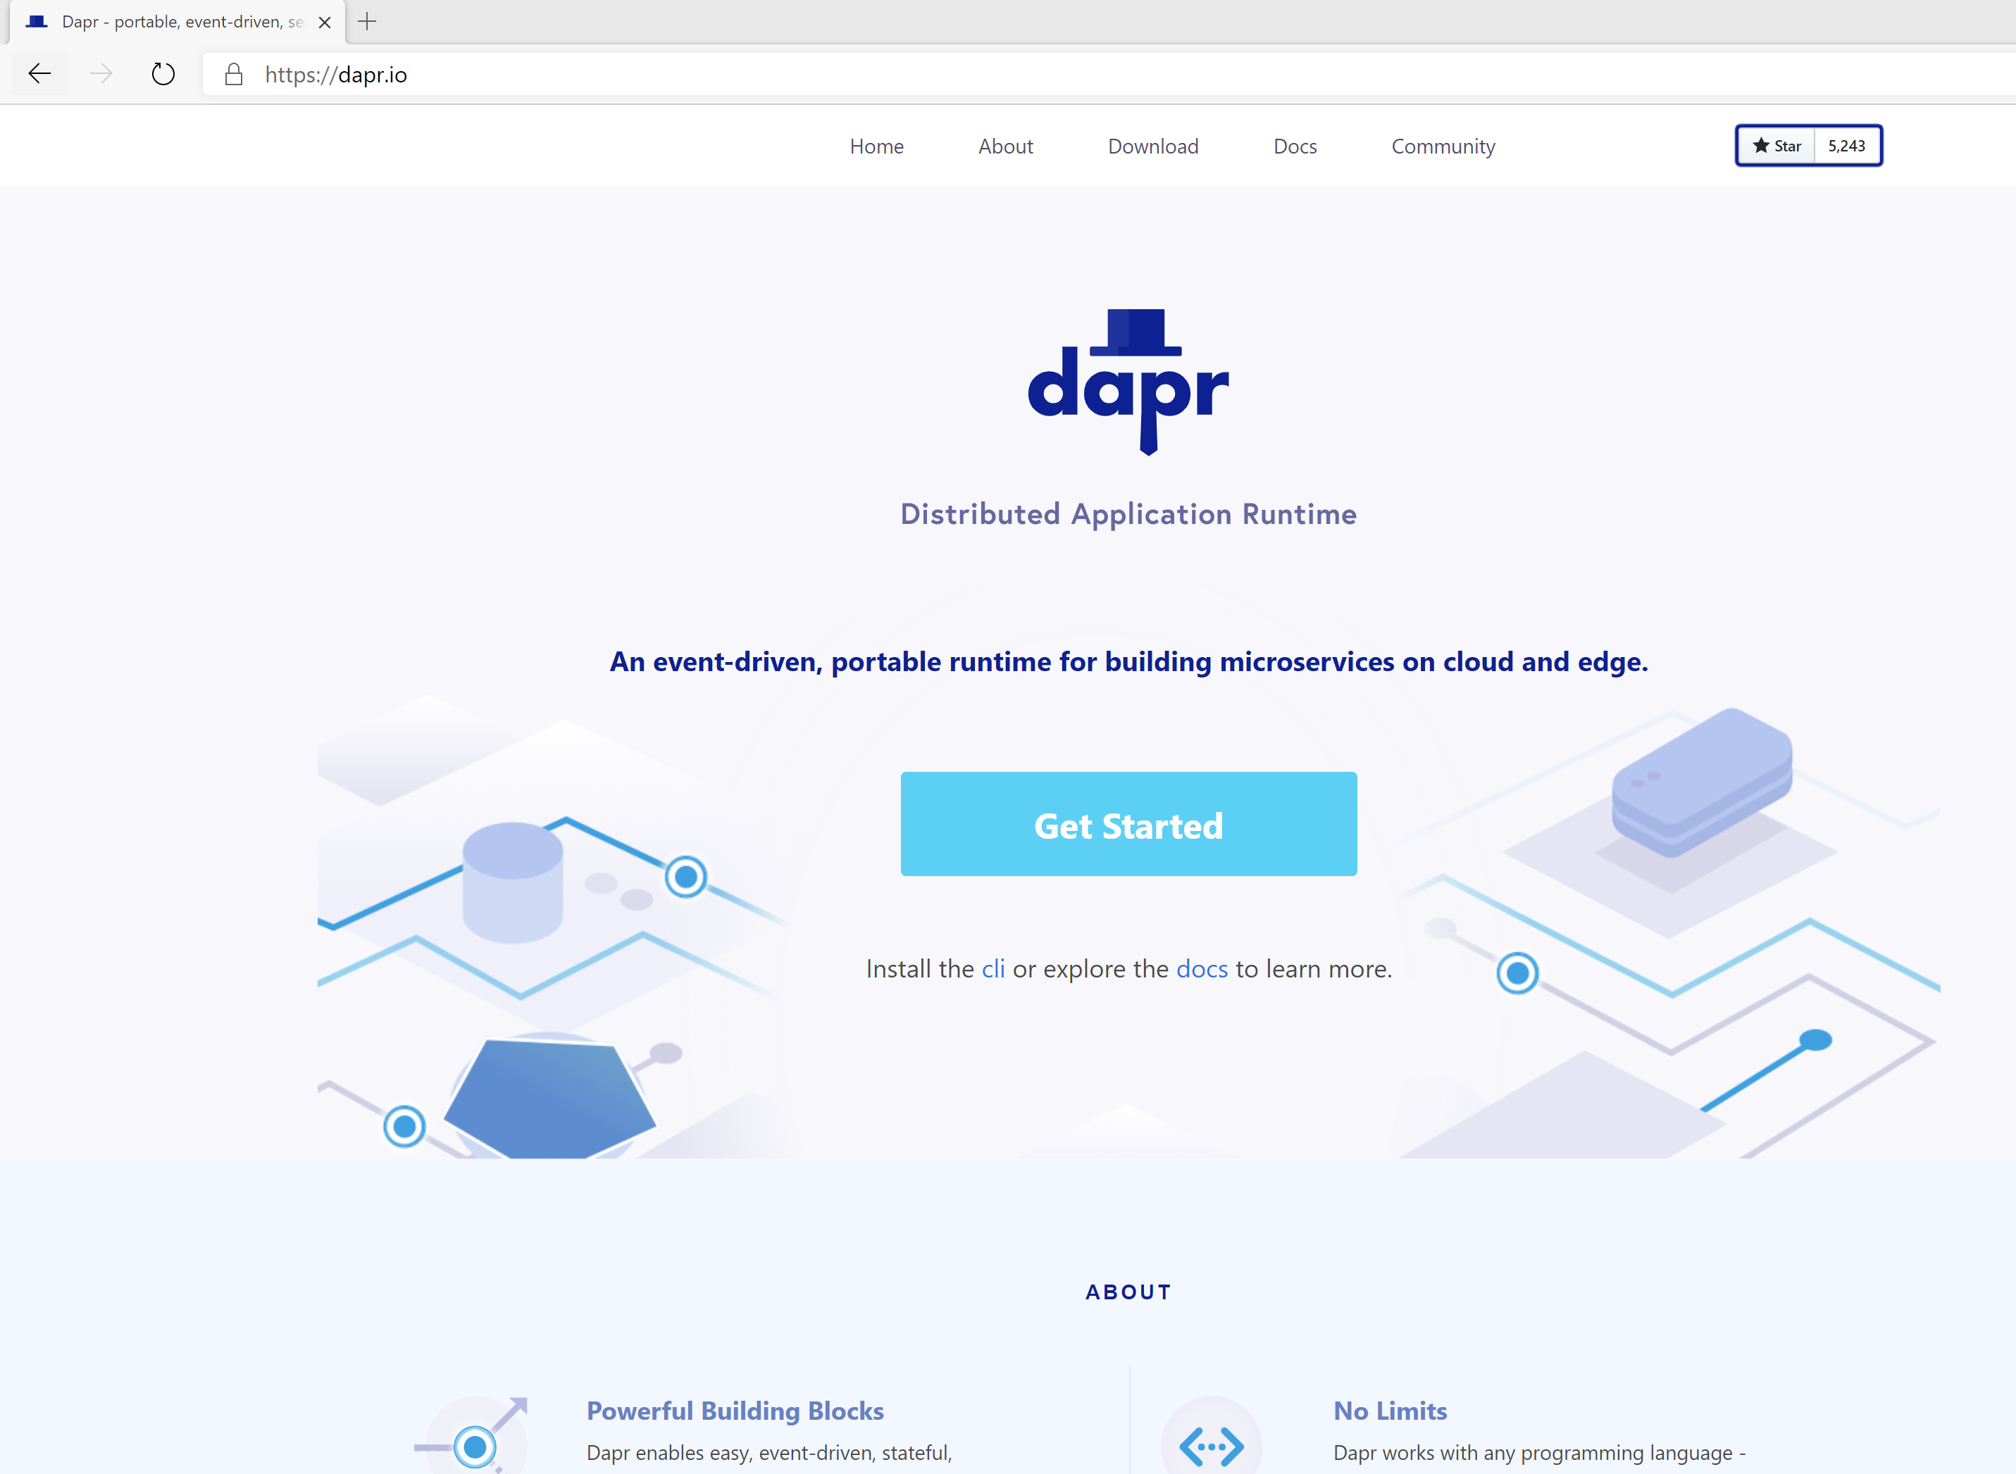

分布式程序运行时
轻量、事件驱动、用于在云和端之间构建分布式应用的运行时
https://dapr.io
开发人员可以专注于构建应用，不用关心基础构建

Slide 4


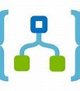






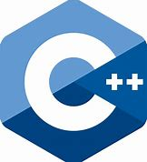
微服务构建模组
应用代码
用以下方式写的微服务
Virtual
Actors
ASP.NET Core
Functions
Logic Apps
API Management
Spring Boot
用以下框架写的微服务
任何代码或框架
HTTP API
gRPC API
Service-to-service invocation
State management
Publish and subscribe
Resource bindings and triggers
Actors
Observability
Secrets
Extensible

Slide 5

边车(sidecar)架构
自服务
应用代码
HTTP/gRPC
Dapr API
基于Kubernetes
Pod
Container
Container
应用代码
HTTP/gRPC
Dapr API
Notes:
It’s important to note that Dapr uses a sidecar architecture. So this means that your application code does not have to include any Dapr code or library.
Instead, the Dapr runtime runs alongside your application, either as a separate process or as a container. And you communicate with the runtime through the API.
For production scenario’s, it’s recommended to use Kubernetes as a host. In that case your application container and the Dapr sidecar container would run together in a single pod.

Slide 6


实例
服务A的Pod
服务B的Pod
容器
容器
容器
容器
Application code
Application code
State Store

Slide 7
71个Dapr组件
27 I/O Bindings
13个通用
7个Azure
5个AWS
18个状态存储
11个Pub/Sub
APNs
Cron (Scheduler)
HTTP
InfluxDB
Kafka
Kubernetes Events
MQTT
PostgreSql
RabbitMQ
Redis
Twilio
Twitter
SendGrid
Azure Blob Storage
Azure EventHubs
Azure CosmosDB
Azure Service Bus Queues
Azure SignalR
Azure Storage Queues
Azure Event Grid
AWS DynamoDB
AWS S3
AWS SNS
AWS SQS
AWS Kinesis
Aerospike
Cassandra
Cloudstate
Couchbase
etcd
Hashicorp Consul
Hazelcast
Memcached
MongoDB
PostgreSQL
RethinkDB
Redis
Zookeeper
Azure CosmosDB
Azure SQL Server
Azure Table Storage
Azure Blob Storage
Google Cloud Firestore
Redis Streams
Apache Kafka
AWS SNS/SQS
Azure Events Hub
Azure Service Bus
GCP Pub/Sub
Hazelcast
MQTT
NATS streaming
Pulsar
RabbitMQ
1个阿里云
Blob Storage
2个GCP
GCP Cloud Pub/Sub
GCP Storage Bucket
8个密钥管理
Azure Key Vault secret store
Azure Key Vault with Kubernetes MI
AWS Secrets Manager
GCP Secret Manager
HashiCorp Vault
Kubernetes Secrets
Local environment variables (for Development)
Local file (for Development)
4个HTTP中间件
2个名称解析
OAuth2
Open Policy Agent (OPA)
Rate limit
Bearer
Kubernetes
Multicast DNS

Slide 8
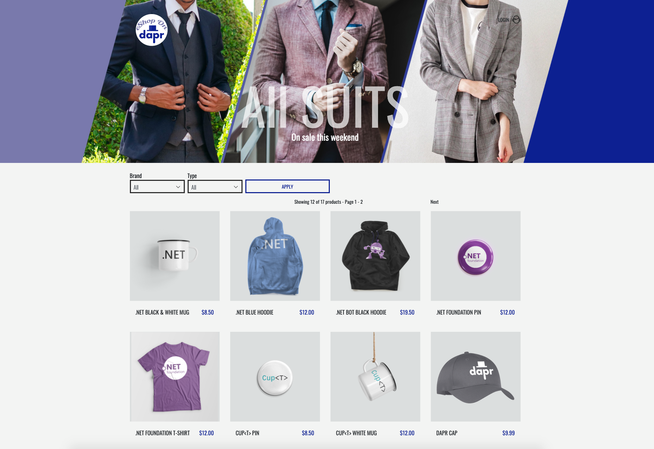
eShop
https://github.com/dotnet-architecture/eShopOnContainers
https://github.com/dotnet-architecture/eShopOnDapr

Slide 9
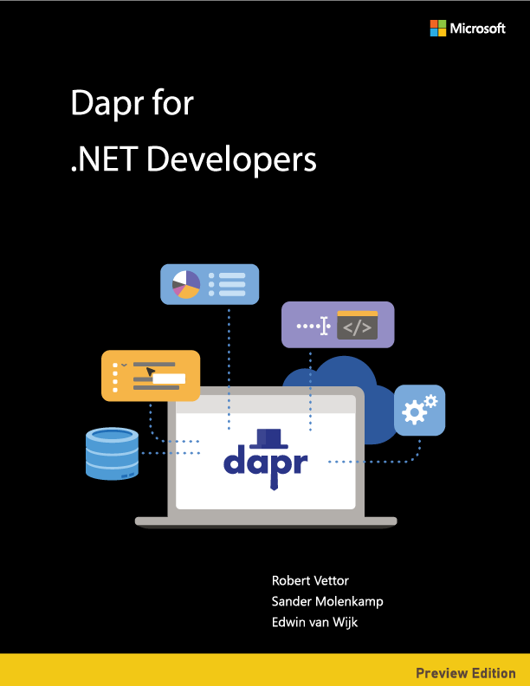
在线版本：
https://docs.microsoft.com/dotnet/architecture/dapr-for-net-developers/
PDF版本：
https://aka.ms/dapr-ebook

Slide 10
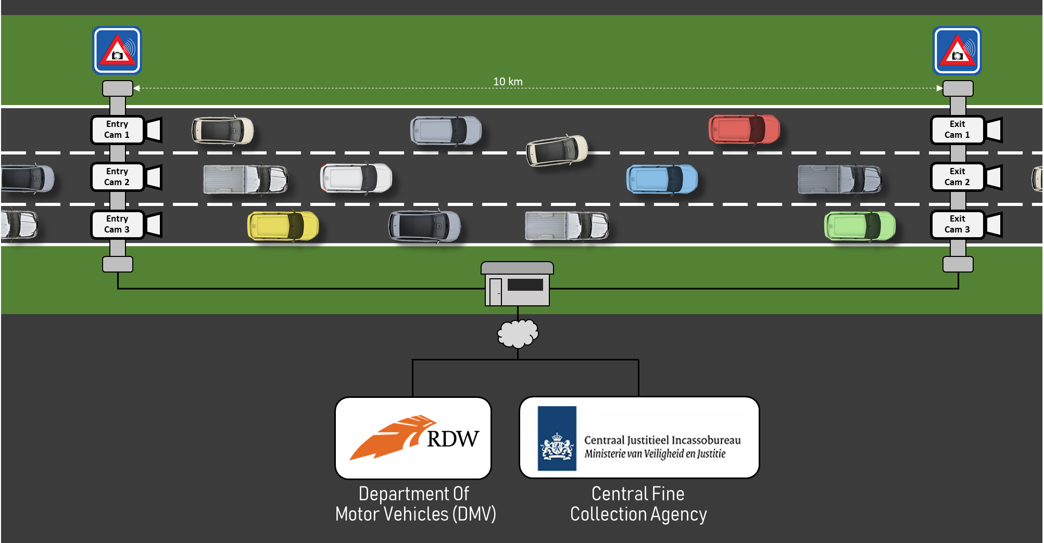


Dapr交通控制实例

Slide 11






Camera
Simulation
MQTT
Sidecar
Traffic
Control
Service
5
5
5
/entrycam
5
/exitcam
2
3
Redis
3
RabbitMQ
2
Sidecar
Fine
Collection
Service
2
2
/collectfine
1
4
6
SMTP
4
1
Sidecar
Vehicle
Registration
Service
Secrets
1
/vehicleinfo/ {license-number}
6
1
服务调用
3
状态管理
5
输入绑定
2
发布 / 订阅
4
输出绑定
6
密钥管理

Slide 12
Dapr如何运行
基于Kubernetes
独立模式 (自服务)
apiVersion: apps/v1
kind: Deployment
metadata:
name: my-go-app
labels:
app: my-go-app
spec:
selector:
matchLabels:
app: my-go-app
template:
metadata:
labels:
app: my-go-app
annotations:
dapr.io/enabled: "true"
dapr.io/app-id: "my-go-app"
dapr.io/app-protocol: ”http"
dapr.io/app-port: ”5000”
…
dapr run --app-id my-go-app \
--app-protocol grpc \
--app-port 5000 \
--components-path ./config \
go run main.go
dapr run --app-id my-net-app \
--app-protocol http \
--app-port 5001 \
--components-path ./config \
dotnet run
dapr run --app-id my-app \
--app-protocol http \
--app-port 5002 \
--components-path ./config \
./my-exe
Notes:
So, how do you get that magical sidecar that does all these things?
Well, on k8s, that’s as simple as decorating your deployment with a few annotations (2 required, enabled, app-id, but there is more)
Dapr will inject a sidecar into your Pod, and your app has the same API you had on your laptop during the development
In a standalone mode (or self-hosted as it is sometimes called) you use the “dapr run” command with a few flags
Whether this is Java, C#, Go, Python or compiled executable

Slide 13

D
E
M
O
Traffic control

Slide 14
上手实验
你将把Dapr加入现有应用
本次工作坊使用的构建组件：
service invocation
pub/sub
state management
bindings
secrets management
从交通控制实例开始，它是基于HTTP实现互相通讯

Slide 15

上手实验
进行工作坊的两种方式：
DIY : 通过学习Dapr文档以及自己研究如何使用Dapr构建组件来实现目标
一步步: 按照一步步指令来操作
完成所有作业，不要跳过任何步骤！
https://github.com/edwinvw/dapr-workshop

Slide 16
资源:
Dapr资料:
https://dapr.io
https://docs.dapr.io
免费电子书: Dapr for .NET Developers
https://aka.ms/dapr-ebook
谢谢!
eShopOnDapr 参考案例
https://github.com/dotnet-architecture/eShopOnDapr
Dapr交通控制示范程序：
https://github.com/edwinvw/dapr-traffic-control

